Slide 1
TEAM 7 Participants:: sarthak singhal nonidh singh mehtaab hazra GAURAV BATRA
INTRODUCTION

Slide 2

PROBLEM
STATEMENT
EA MEGATHON CHALLENGE
THEME:
IT’S INSIDE THE “SCHRODINGER’S BOX”

Slide 3
IMPLEMENTATIONS IN GIVEN TIME CONSTRAINT
Since 24 hour time is very less to implement a full functioning game using a gaming engine like unity or real engine we have focussed more on presenting our idea with only basic implementation
Beside we have a very little knowledge of these game engines and everything has been done from scratch in the last 24 hour period.

Slide 4

OUR IDEA
Our main idea is to integrate the concept of gaming with the current buzzword
`FITNESS`

Slide 5
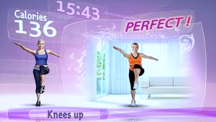
FITNESS AND GAMING
Fitness as of such doesn’t need any explanation and has become most important aspect of one’s life.
Gaming is the go-to stress buster accessible to anyone anywhere.
Presently there exist many fitness apps and games, but a combination of both is not there right now.
Promoting fitness through gaming in which the player will level up only after he performs a specific task will force the player to do some kind of physical exercise in order to move ahead in the game.

Slide 6
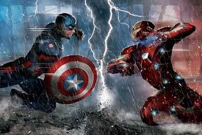
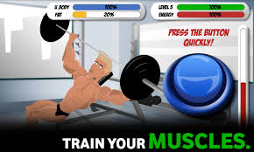
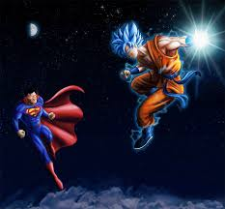
BASIC model OF OUR GAME
Our game contains a character who has unknown super powers and discovers them only after some time later when he goes through a bad phase in his life. In order to overcome the enemies he must level up which is linked to his fitness. Only after he does some sort of physical exercise, he power ups which enables him to defeat stronger enemies.

Slide 7
Since main feature which makes our game stand out is integrating fitness related activities with the game, we would discuss about the technologies which would allow us to do this in a bit more detail.

Slide 8
FITNESS INTEGRATION WITH THE GAMEPLAY

Slide 9

TECHNOLOGY USED::
OPENCV
PYTHON

Slide 10




FITNESS DATA measurement

Slide 11
INBUILT MOBILE TECHNOLOGIES
PROXIMITY SENSOR
ACCELEROMETER

Slide 12
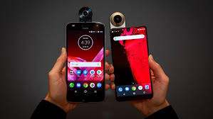
PROXIMITY SENSOR
Phone’s proximity sensor, is a sensor that can detect nearby objects without physical contact. The main use of a proximity sensor in phones is so that the phone knows when it’s being used in a call and is against a person’s ear. This then tells the phone to turn the screen off or lock the phone so nothing is accidentally pressed.

Slide 13
ACCELEROMETER
The function of the accelerometer chip in phones is so it can detect which way the screen is being held and change the display accordingly. It can also detect acceleration, whether caused by gravity or by movement. Because an accelerometer can detect movement and gravity it knows exactly what angle it’s being held at in space.

Slide 14
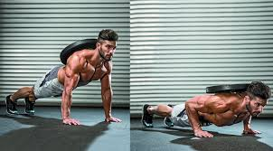
TEST CASE 1) TRACKING PUSH UPS:
This uses the phone’s proximity sensor. The use of the phone’s proximity sensor means you don’t need to touch your phone screen with your nose to count a push-up – just get close. For greater accuracy do a proper push-up by getting low enough to trigger the sensor.

Slide 15
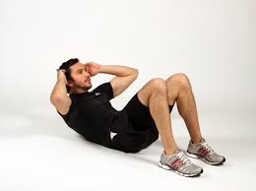
TEST CASE 2) TRACKING SIT UPS::
This uses the phone’s built-in accelerometer to detect movement. One need to hold the phone against the chest then sit up quickly enough and high enough for the accelerometer to register the movement and the app to count 1 sit-up.

Slide 16
INTEGRATING RESULTS INTO THE GAME
The game would be built in such a way that it can interact with the sensors and accelerator and can incorporate their data into the system.
This data can be updated in real time using the available technologies and can make the game more interacting.

Slide 17
GAME
DESIGN

Slide 18
TECHNOLOGY USED::
UNITY
C#

Slide 19

STORYLINE(flexible)
The story begins when the main character goes to a party with his girlfriend.
They enjoy a lot but after some time he notices that his girlfriend is missing.
He comes to know that a group of people(having super powers (like captain America)) have put her in a prison on suspicion of her being evil.

Slide 20

CONT..
He wants to fight them but realizes that he needs a lot of training.
He finds a master and goes with him for training.
Here he gets power based on tasks completed by him(basically fitness tasks).

Slide 21
CONT..
As he moves ahead in the game he realizes that the people who have kidnapped her girlfriend have some misconception and in the whole game he makes efforts to make them realize about their mistake.
Thus he moves forward taking them down and thereby becoming more fit.

Slide 22
CONT..
Thus our game’s story is like a typical fight between two good persons(super heroes) which occurs due to misunderstanding between them.
This theme engages the users(just like Captain America vs Iron Man ) and will be pretty good for users.

Slide 23
advantages
This is quite a good concept as the whole world loves to play console based games but are reluctant to try out any new exercise.
This concept will force them to work hard in order to progress in the game. Thus through this we try to improve youth health by creating a game which would require them to exercise.

Slide 24
CONCEPT OF LEVELS
Levels are increased automatically as one does more and more exercises and thus can defeat more stronger opponent and advance forward to unlock more exciting challenges.

Slide 25
FINAL OUTCOME

Slide 26

Final outcome as visualised by us is a game which would engage users in it’s gameplay and side by side force them to improve their health.
We try to integrate the motion data captured by the cameras into the game in real time which would show corresponding effect in the game and help the gamer to power up.

Slide 27
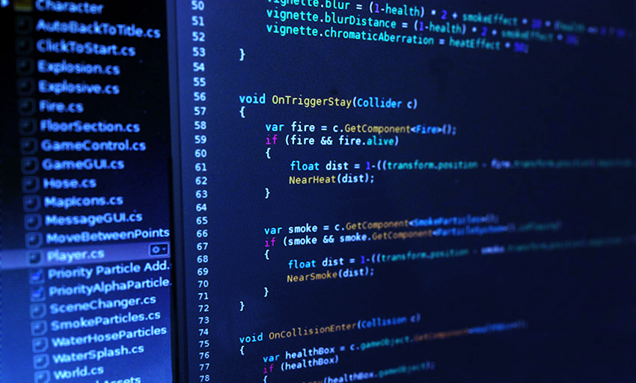
CODE
SNIPPETS

Slide 28
OPENCV AND PYTHON FOR MOTION DETECTION
Since some of us were already working on projects related to OpenCV, motion detection was relatively easy for us to implement than the unity based game.

Slide 29
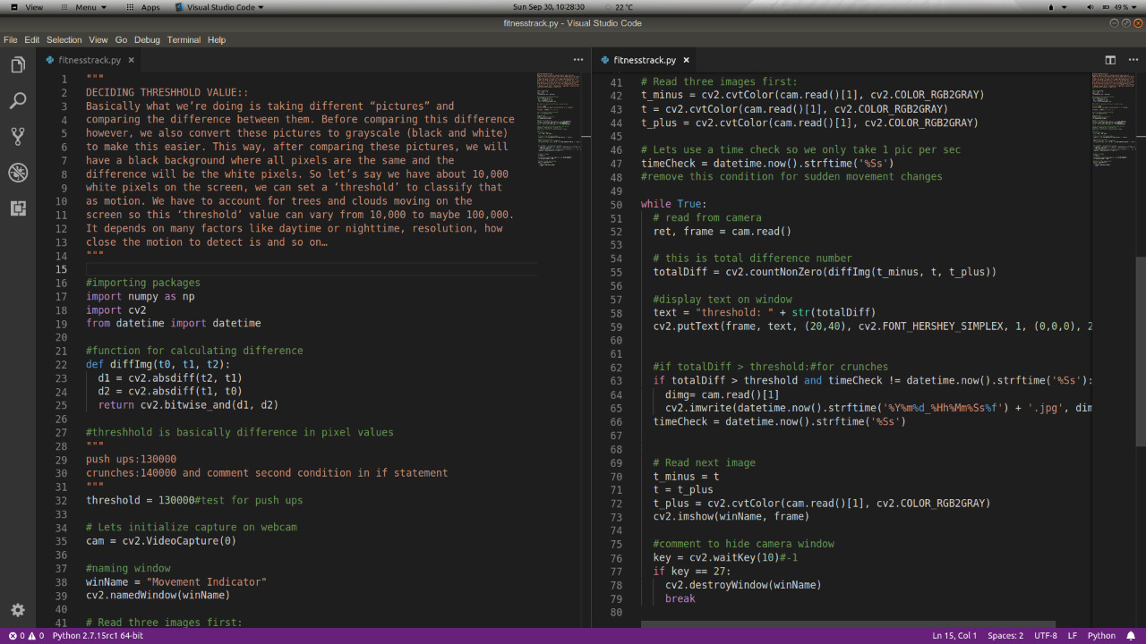

Slide 30
This script basically uses web cam to capture set of three images and checks if there is any motion by calculating difference in number of white pixels of the three images and if any difference is found saves the image and thus detects motion.
Amount of motion to be detected can be decided by setting time and difference parameters.

Slide 31
UNITY 3D AND C# FOR BUILDING GAME
Since we are new to both unity and c# we have worked on boilerplate templates to implement the gameplay.

Slide 32
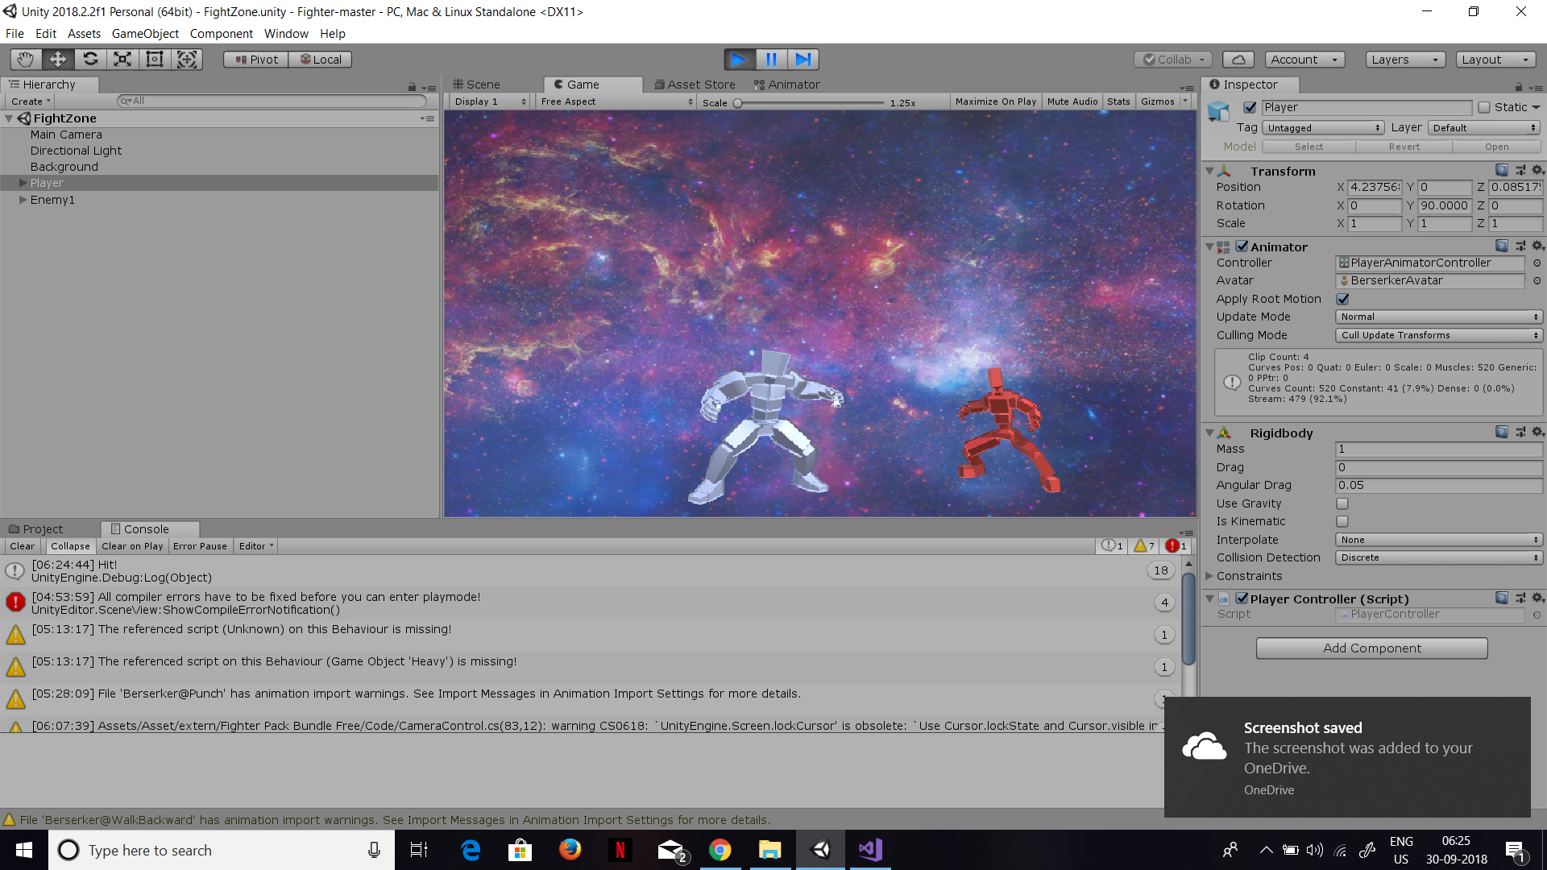

Slide 33


Slide 34


Slide 35
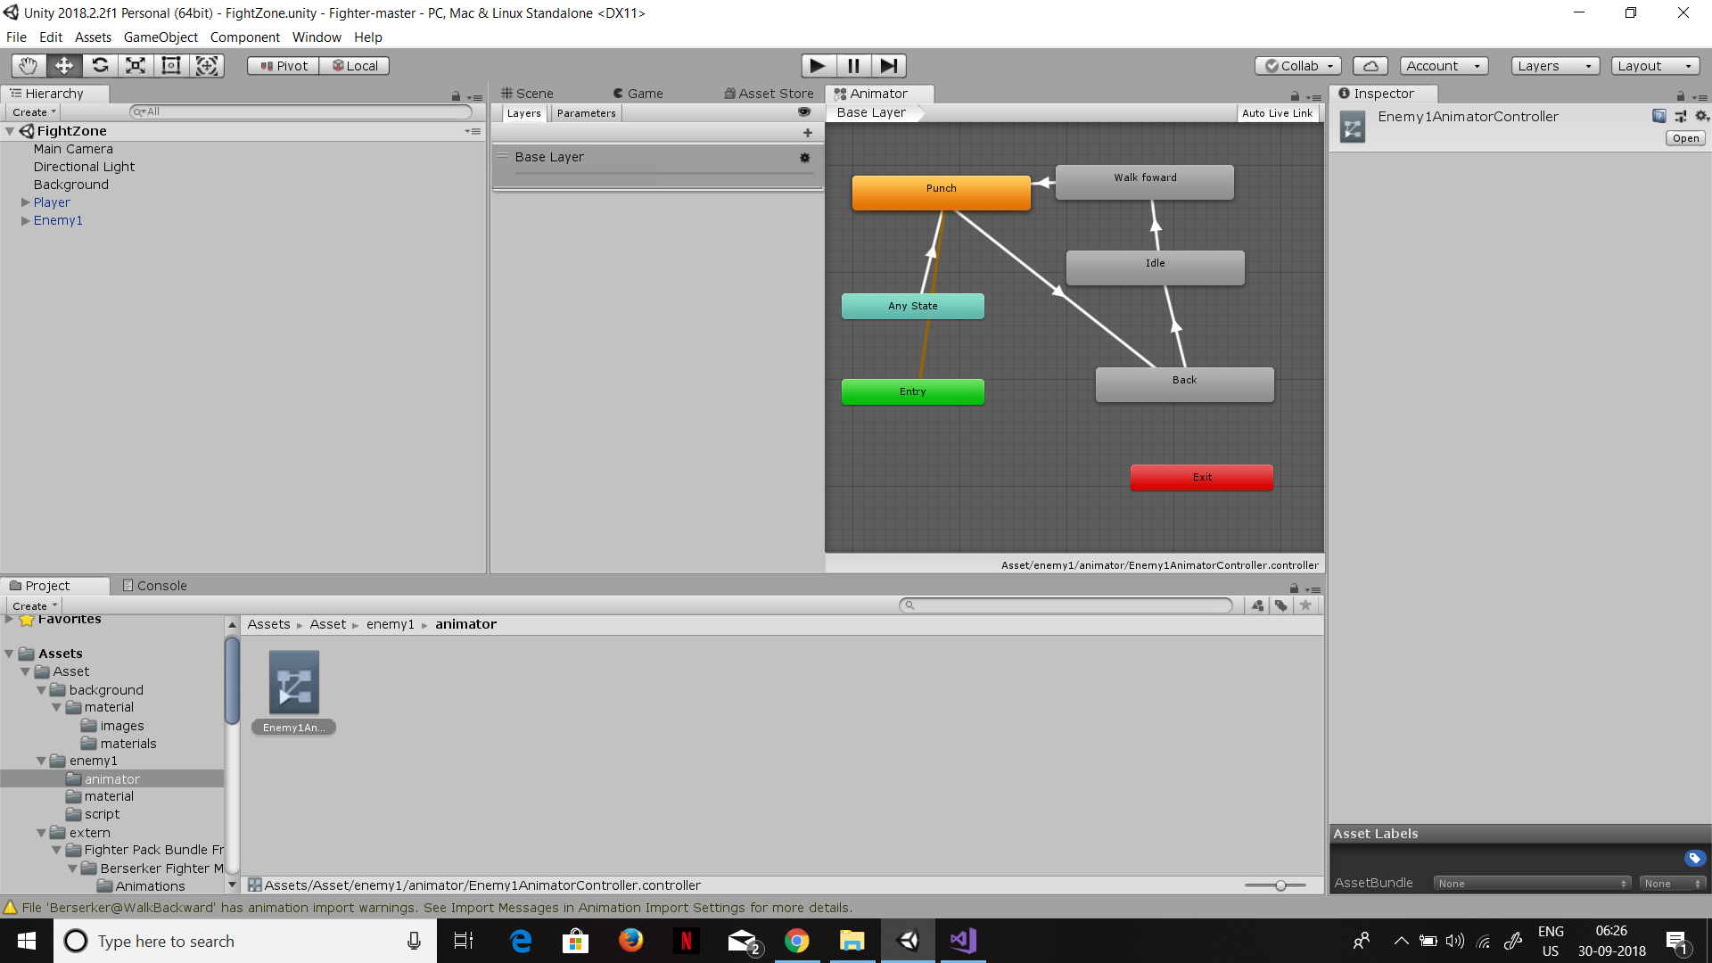

Slide 36
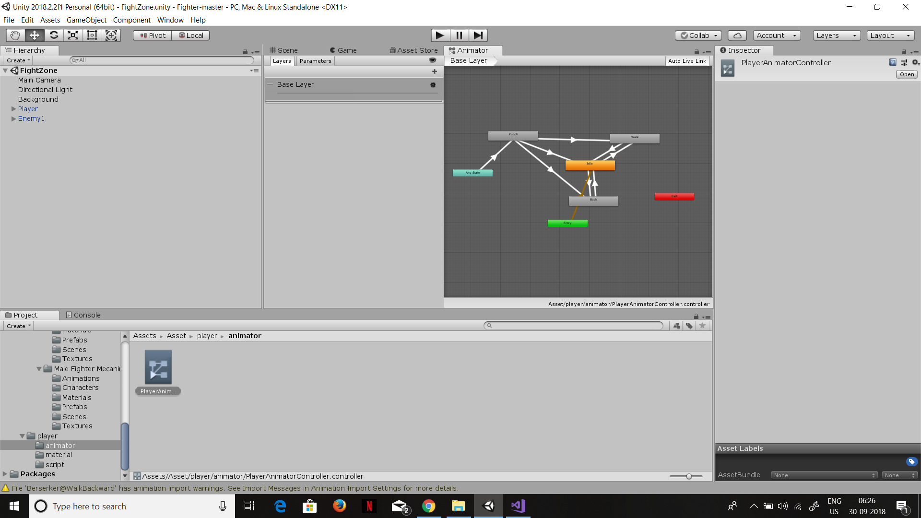

Slide 37
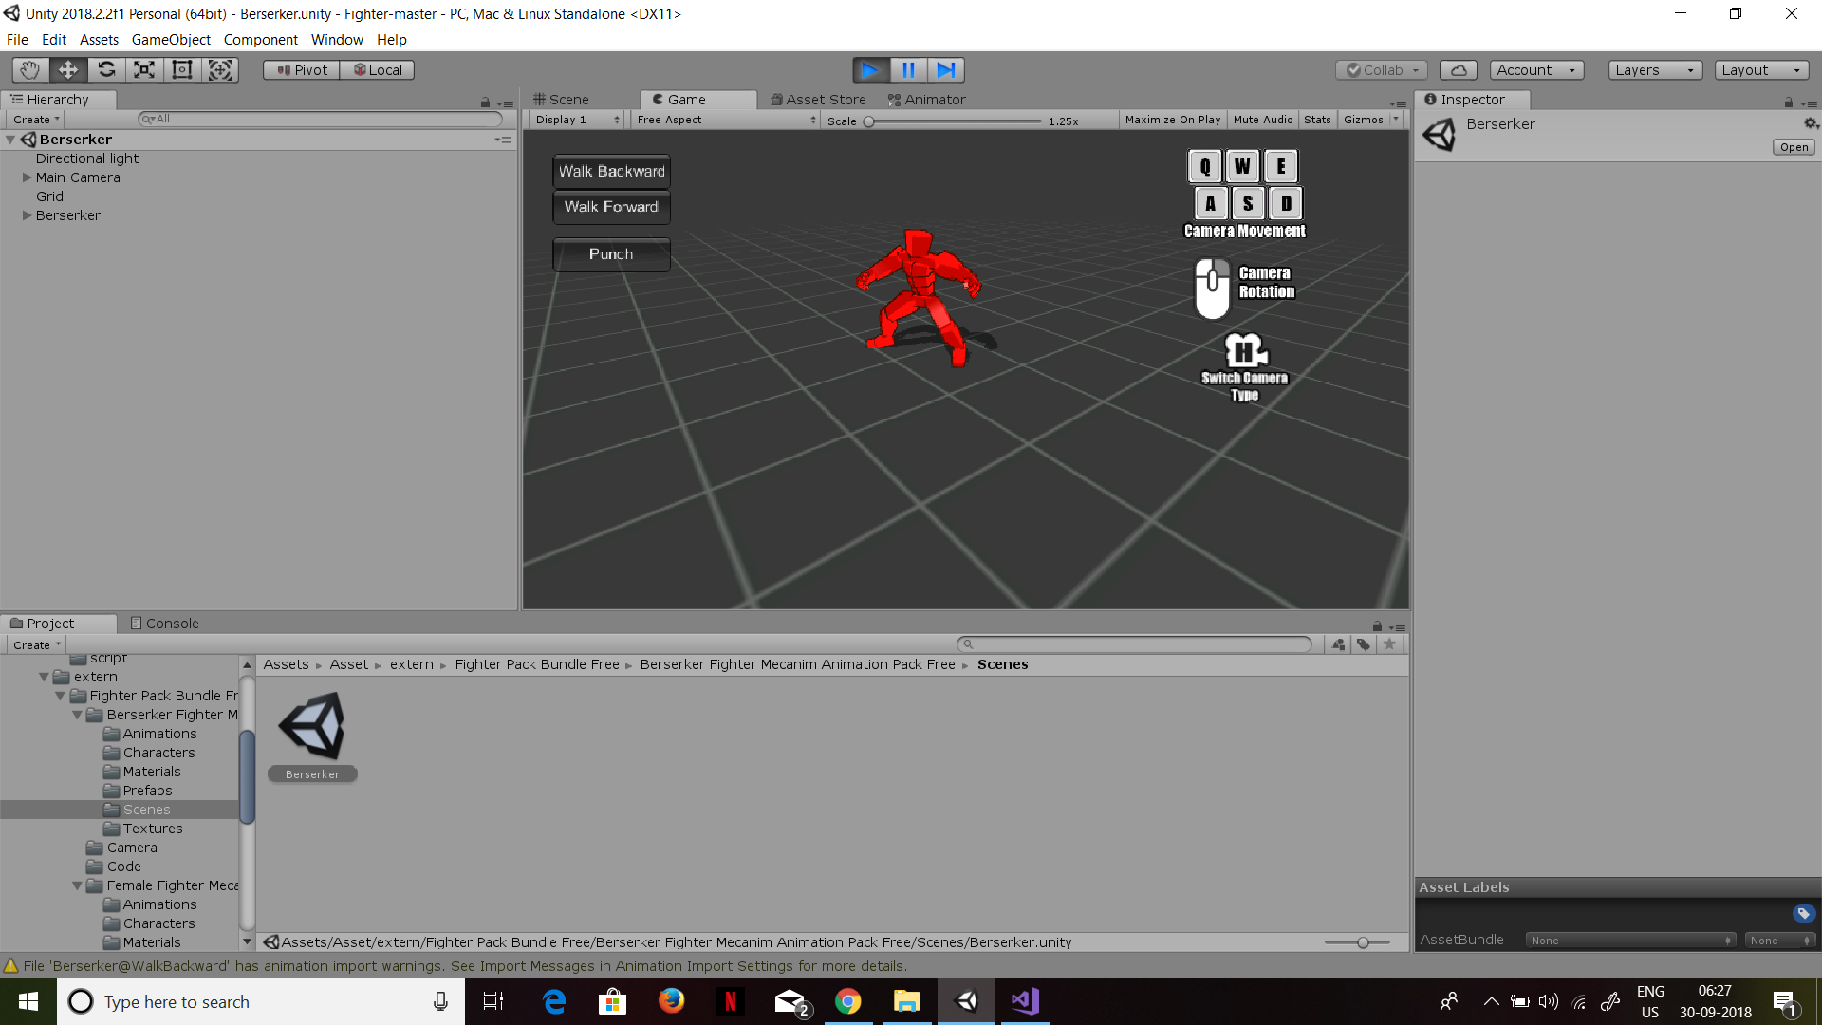

Slide 38
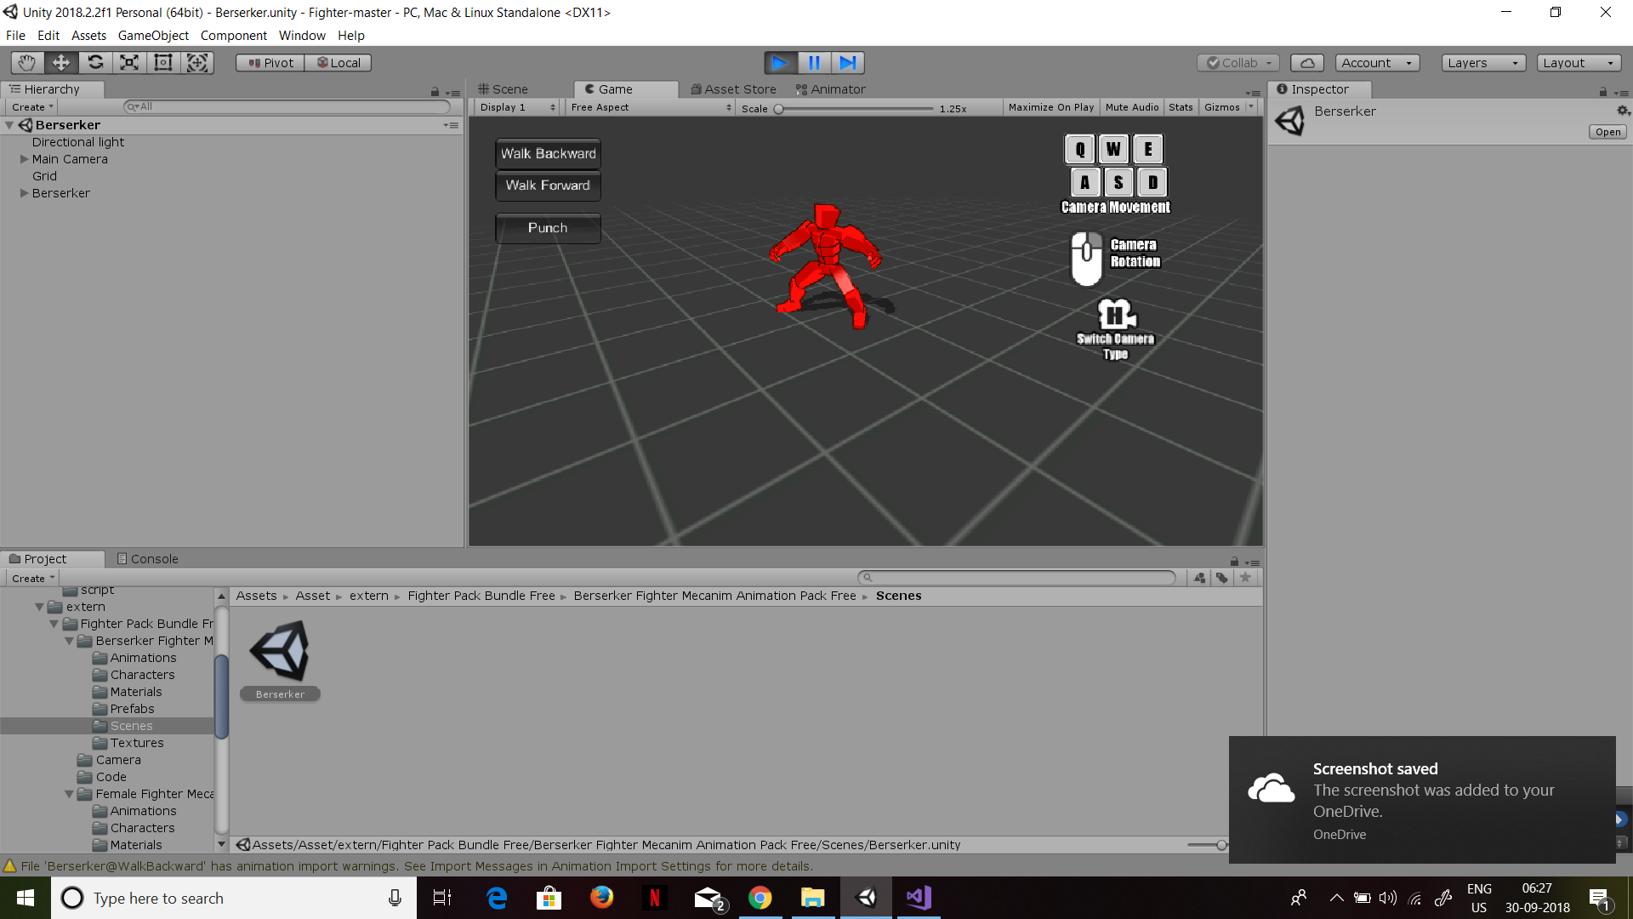

Slide 39
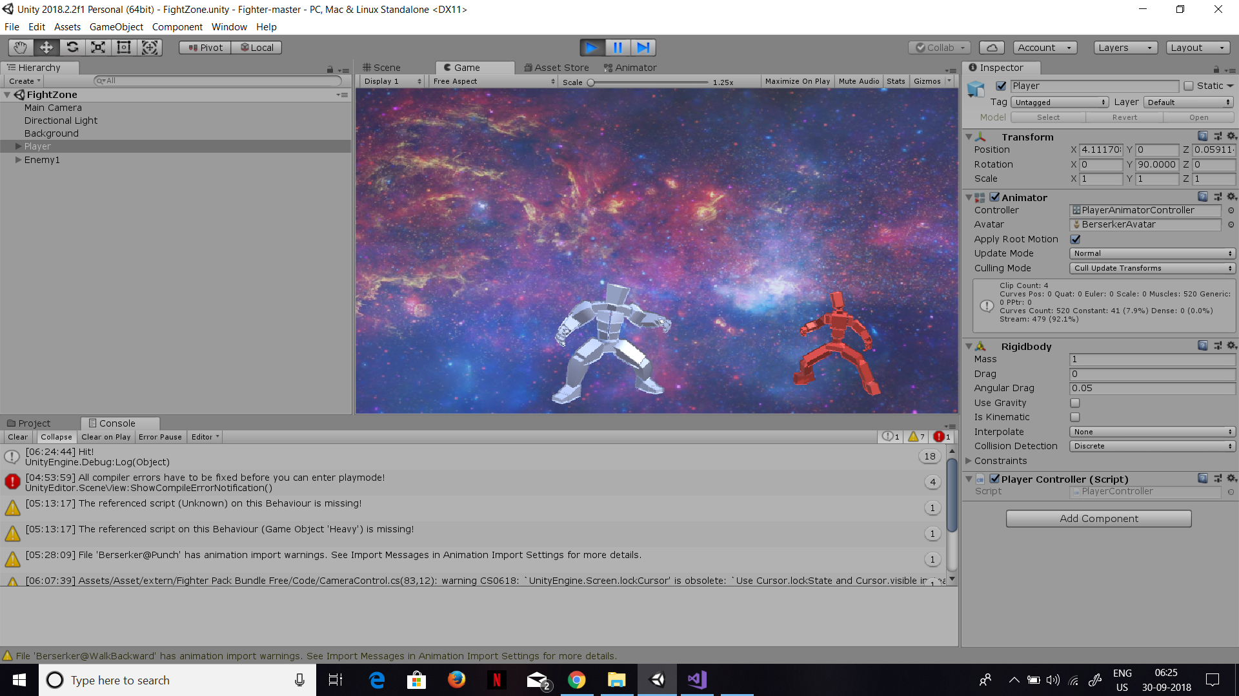

Slide 40

THE
END

Slide 41

MEGATHON ORGANIZERS
EA SPORTS MENTORS
IIIT-H TEACHERS
ALL OTHER ORGANISING PEOPLE

